Slide 1
IMAGE COMPRESSION
VIT UNIVERSITY
Abhishek Agrawal (09BCE327)
Ansul Gupta (09BCE208)
Vibhor Mishra (09BCE194)

Slide 2
Project Goals
K-means Algorithm
Bit-Map Generation
Run-Length Encoding

Slide 3
AIM
To perform lossless compression of image using k-means clustering, bit-map generation and run-length encoding.

Slide 4
METHODOLOGY
K-means Clustering Algorithm
Easy to implement
Faster than other primitive clustering algorithms
Run-length Encoding
Simple and effective way to reduce size
Easy to decode the original image

Slide 5
PROGRESS SO FAR…
Analyzed base-paper on image compression
Completed implementation of k-means algorithm
Implementation of bit-map generation
Implementation of run-length encoding (RLE)
Implementation of decoding process

Slide 6
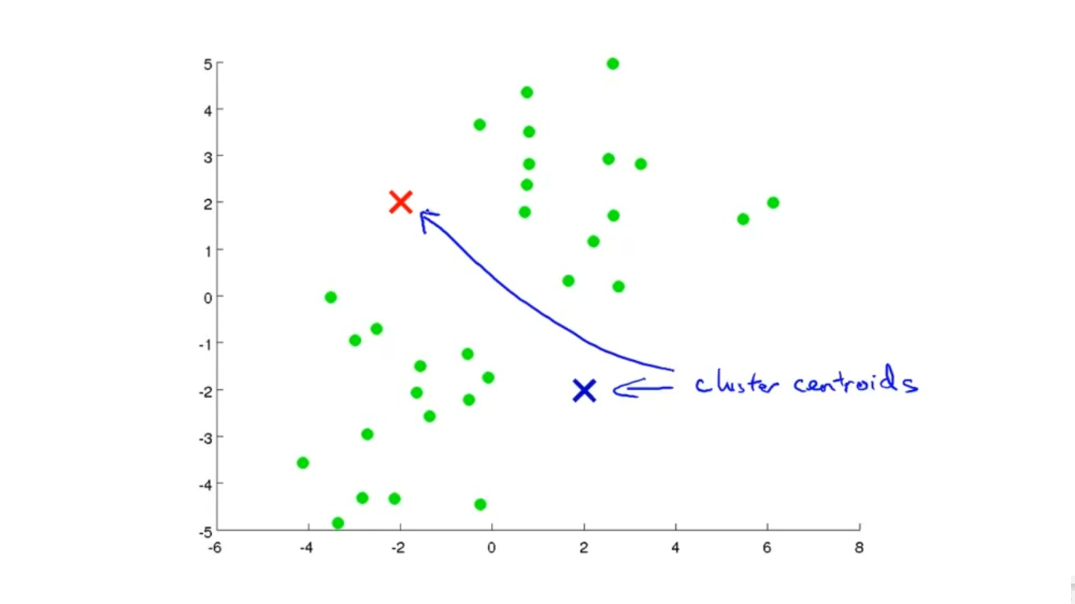
K-means Algorithm in action!!

Slide 7
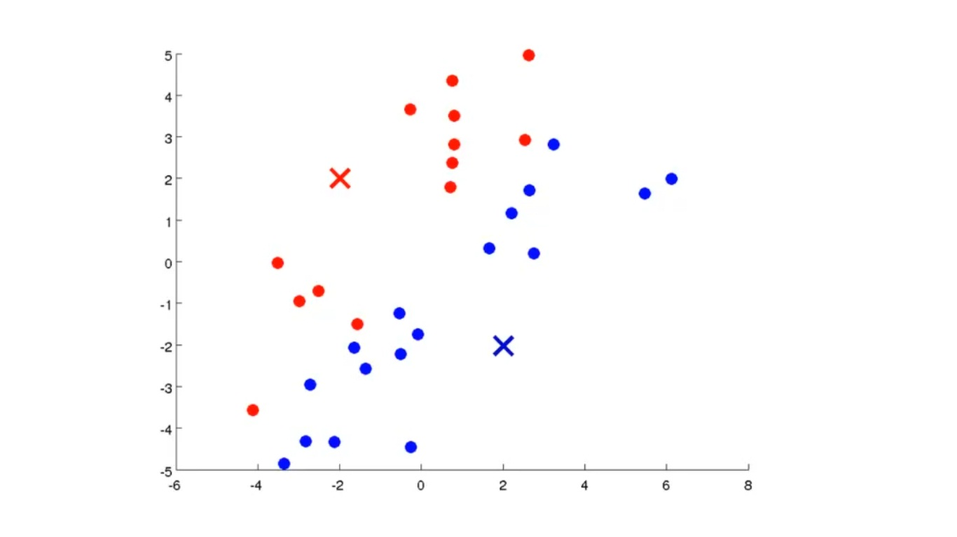

Slide 8
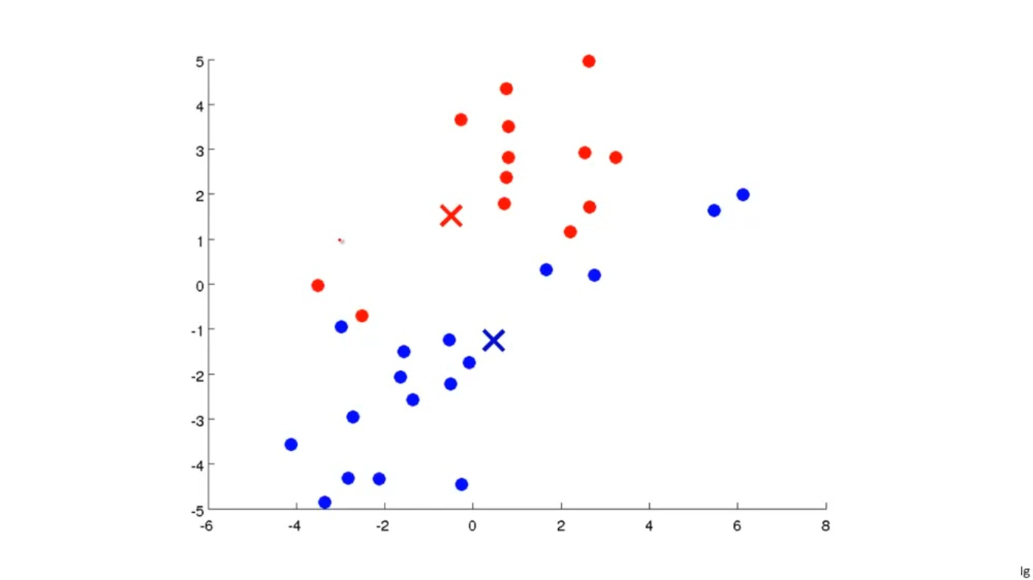

Slide 9
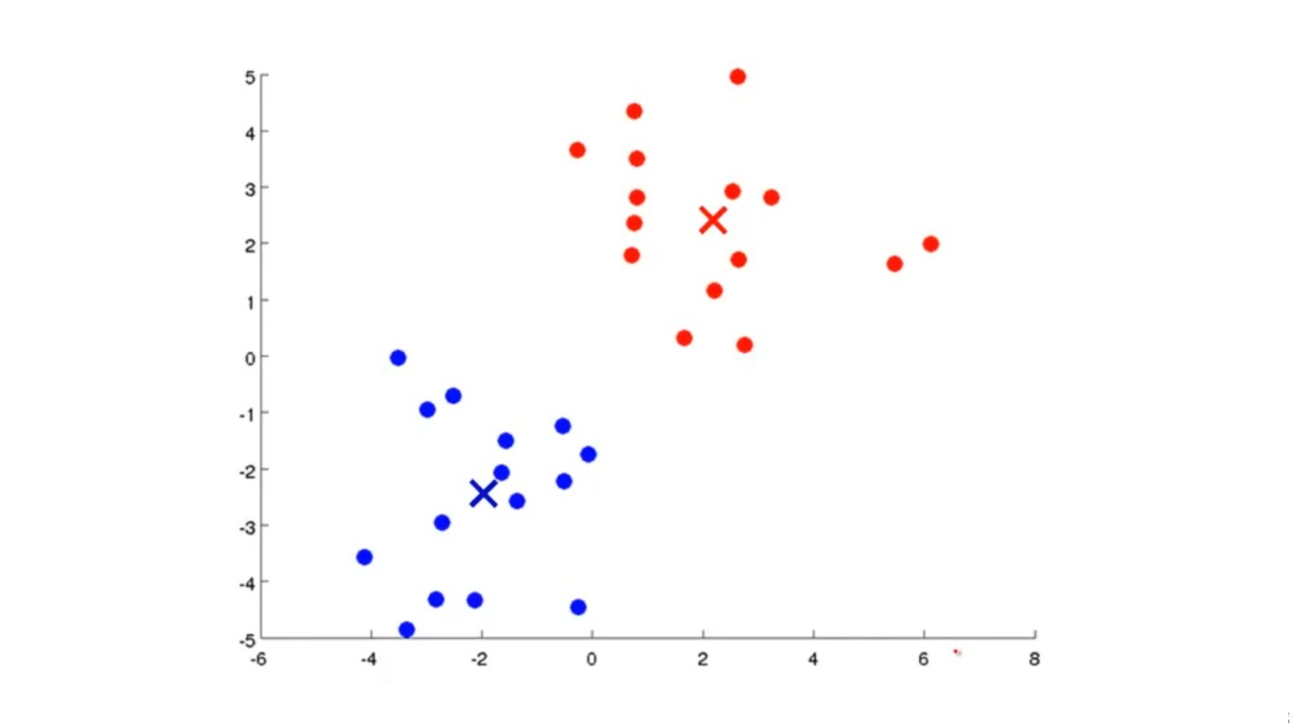

Slide 10
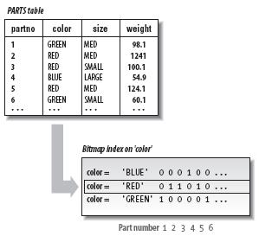
Bit-map generation

Slide 11
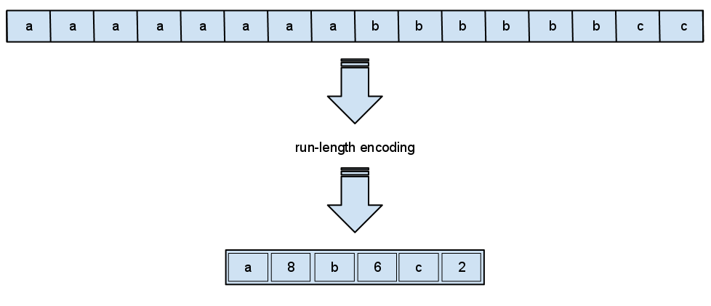
Run-length encoding

Slide 12


Results
Original image After compression

Slide 13


Results (Contd..)
Original Image After Compression

Slide 14


Results (Contd..)
Original image After compression

Slide 15


Results (Contd..)
Original image After compression

Slide 16
Conclusion
Image compression is performed by k-means, bit-map encoding and RLE.
The greater the dimensions of the image more is the compression performed by RLE.
K-means performs lossy compression whereas RLE performs lossless compression.

Slide 17
References
Ayan Banerjee, Amiya Halder, “An efficient image compression algorithm for most dual color image based on k-means clustering, bit-map generation and RLE”
International Conference on Computer and Communication Technology [ICCT’10]
http://www.mathworks.in/help/matlab/ref/fprintf.html
http://www.mathworks.in/help/matlab/ref/strcat.html

